Slide 1
Enhancing Real Estate Investment Decisions with Predictive Modeling
The real estate market involves large investments, making accurate property valuation important for investors and buyers.
Property prices depend on several factors such as location, quality, living area, construction, garage, basement, and property condition.
Traditional valuation methods may not fully capture the complex relationships between these factors.
Machine Learning can analyze historical property data and learn patterns that influence property prices.
This project develops a predictive modeling system to estimate residential property prices and identify the most important factors affecting valuation.
The insights can help Surprise Housing make better investment decisions and identify potentially valuable properties.
achine Learning Based Residential Property Price Prediction

Slide 2
Project Overview
Project Type: Machine Learning – Regression
Objective: Predict residential property prices using historical housing data.
Dataset: Ames Housing Dataset – 1,460 records
Target Variable: SalePrice
Key Features: Overall Quality, Living Area, Basement Area, Garage Area, Lot Area, Year Built
Data Processing: Missing-value handling, encoding, scaling, and feature engineering
Models Used: Linear Regression, Ridge, Lasso, Random Forest, Gradient Boosting
Best Model: Tuned Gradient Boosting Regressor
Performance: RMSE = $35,538.86 | R² = 0.819
Business Use: Supports property valuation, investment screening, price comparison, and data-driven decisions.

Slide 3
Problem Statement & Objectives
Problem Statement
Accurately predicting residential property prices is challenging due to the complex relationship between property features, making data-driven valuation essential for better investment decisions.
Objectives:
Build a Machine Learning model to predict residential property prices.
Analyse the key factors influencing property prices.
Compare multiple ML algorithms and select the best-performing model.
Tune the selected model to improve prediction accuracy.
Provide insights to support better real estate investment decisions.

Slide 4
Data Collection & Preprocessing
Dataset: Ames Housing Dataset with 1,460 property records and 81 features.
Target: SalePrice — actual selling price of each property.
Data Cleaning: Handled missing values and separated the Id column from modeling.
Categorical Data: Missing categories were treated appropriately and converted using One-Hot Encoding.
Numerical Data: Missing numerical values were handled using median/zero imputation where appropriate.
Feature Scaling: Numerical features were standardized using StandardScaler.
Final Data: Prepared a clean dataset suitable for Machine Learning model training and evaluation.

Slide 5
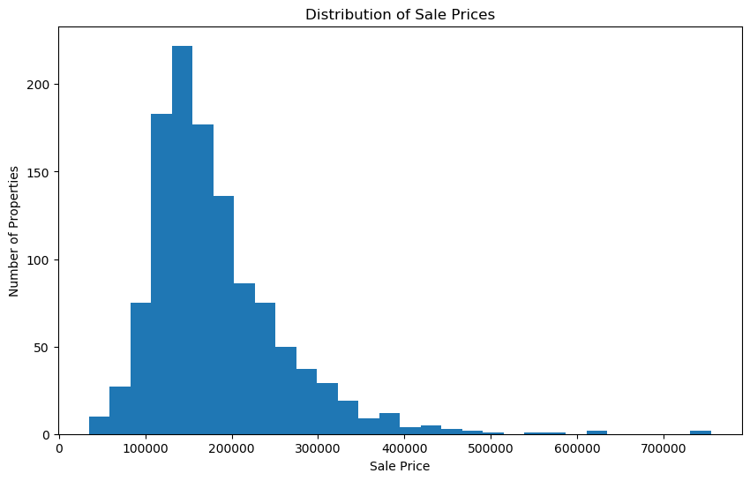
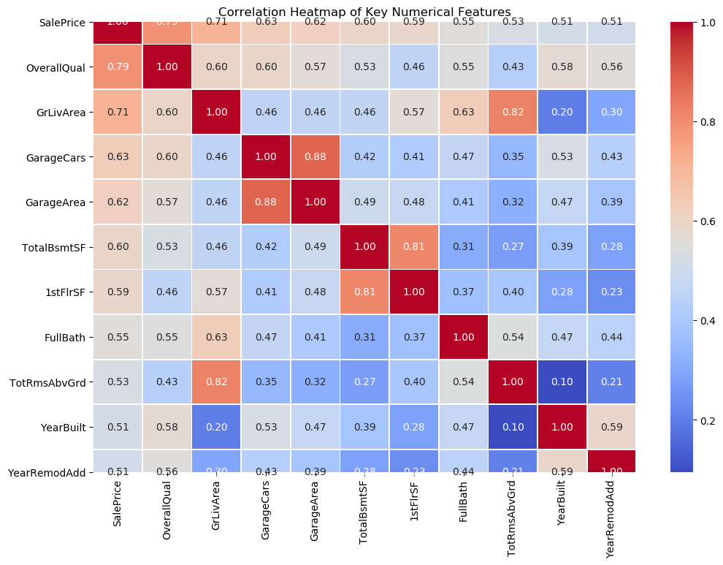
EDA Findings
Graph 1: SalePrice Distribution
Graph 2: Correlation Heatmap
Findings:
Most properties are concentrated in the lower-to-middle price range.
The distribution is right-skewed, with a smaller number of high-priced properties.
Mean price is approximately $181,477, compared with a median of $163,995
Findings:
OverallQual has the strongest correlation with SalePrice (0.789).
GrLivArea is the second strongest (0.707).
GarageCars, GarageArea, TotalBsmtSF and 1stFlrSF also show strong positive relationships.

Slide 6
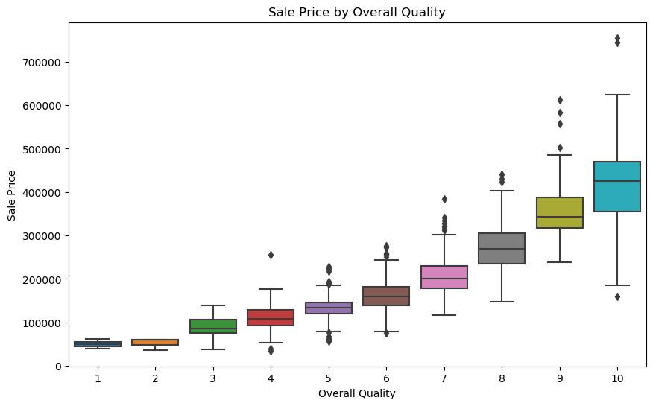
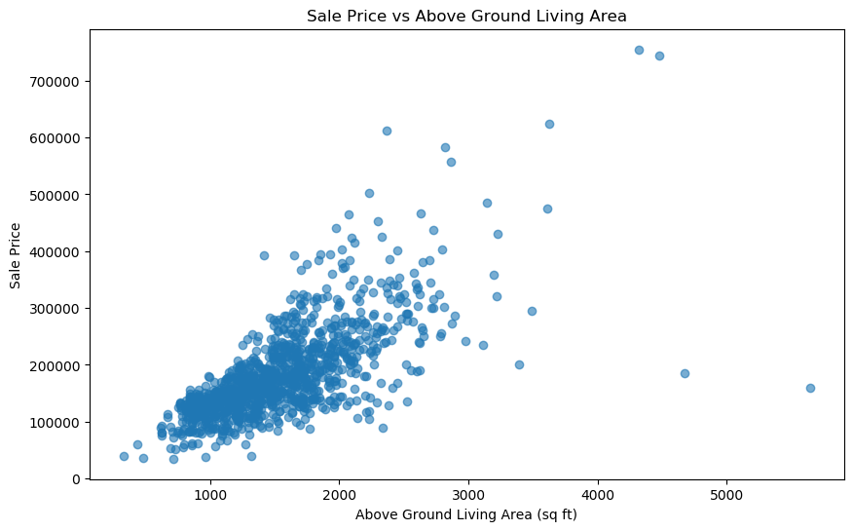
Graph 3: OverallQual vs SalePrice
Graph 4: GrLivArea vs SalePrice
Findings:
Higher OverallQual generally leads to higher property prices.
A clear upward trend is visible across quality ratings.
This confirms OverallQual as a major price-related feature
Findings:
Larger above-ground living areas generally have higher sale prices.
The relationship is positive but not perfectly linear.
Properties with similar living areas can still have different prices because of quality, location and other characteristics.

Slide 7
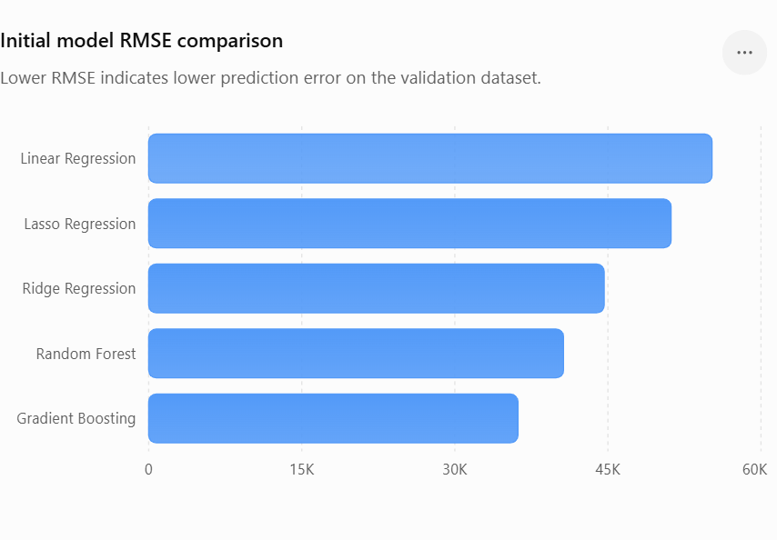
Model Comparison
Model | RMSE ($) | R²
Linear Regression | 55,206.38 | 0.5632
Ridge Regression | 44,635.85 | 0.7144
Lasso Regression | 51,195.56 | 0.6243
Random Forest | 40,649.85 | 0.7632
Gradient Boosting | 36,178.66 | 0.8124
Gradient Boosting achieved the lowest RMSE and highest R², making it the best-performing initial model.

Slide 8
Hyperparameter Tuning
Selected Model: Gradient Boosting Regressor
Tuning Method: GridSearchCV with 5-Fold Cross-Validation
Parameters Tuned:
  Number of Estimators
  Learning Rate
  Maximum Depth
  Minimum Samples Leaf
  Subsample
Best Parameters:
  n_estimators = 200
  learning_rate = 0.10
  max_depth = 3
  min_samples_leaf = 2
  subsample = 0.80
Performance Improvement
Before Tuning
RMSE: $36,178.66
R²: 0.8124
After Tuning
RMSE: $35,538.86
R²: 0.8190
Key Finding
Hyperparameter tuning improved the Gradient Boosting model, achieving lower prediction error and higher R².

Slide 9
Final Evaluation
Final Model Performance
Final Model: Tuned Gradient Boosting Regressor
Metric | Result
RMSE | $35,538.86
R² Score | 0.8190
Key Findings
The tuned Gradient Boosting model achieved the best overall performance.
RMSE of $35,538.86 indicates a lower prediction error compared with the initial models.
R² of 0.8190 means the model explains approximately 81.9% of the variation in property prices.
The model provides a strong basis for residential property valuation and investment screening.

Slide 10
Feature Importance Analysis
Top Features Influencing Property Price
Key Findings
OverallQual is the most important feature, with approximately 47.3% importance.
GrLivArea is the second strongest feature, with approximately 15.1% importance.
TotalBsmtSF, GarageArea and YearRemodAdd are the next important predictors.
Property quality and living area are the dominant predictive signals.
Basement, garage, renovation, lot size and construction characteristics also contribute to price prediction.
Business Insight
Rank | Feature | Importance
1 | OverallQual | 47.3%
2 | GrLivArea | 15.1%
3 | TotalBsmtSF | 4.8%
4 | GarageArea | 3.5%
5 | YearRemodAdd | 3.1%
6 | BsmtFinSF1 | 2.1%
7 | GarageYrBlt | 2.1%
8 | 1stFlrSF | 1.8%
9 | LotArea | 1.7%
10 | YearBuilt | 1.5%

Slide 11
Business Implications
Property Acquisition: Compare predicted price with acquisition cost to identify attractive properties.
Property Valuation: Provides a data-driven reference for estimating property value.
Renovation Strategy: Prioritize improvements in quality, living area, basement, garage, and modernization.
Pricing Strategy: Use predicted price as a reference for setting an initial asking price.
Market Screening: Identify high-value property characteristics and prioritize properties for further analysis.
Investment Decisions: Helps reduce the risk of overpaying and supports better investment prioritization.

Slide 12
Conclusion & Future steps
Conclusion
The project successfully developed a machine learning-based system for predicting residential property prices using historical housing data. Among the models evaluated, the Tuned Gradient Boosting Regressor achieved the best performance with an RMSE of $35,538.86 and R² of 0.8190. The analysis identified Overall Quality and Living Area as the most influential factors affecting property prices. The model can therefore support data-driven property valuation, investment screening, pricing, and acquisition decisions.
Future Steps
Validate the model using current and local real-estate data.
Include location, neighborhood, economic, and market-demand factors.
Experiment with advanced models such as XGBoost and LightGBM.
Apply temporal and repeated cross-validation for better reliability.
Develop an interactive dashboard or API for practical use.
Continuously monitor and retrain the model as market conditions change

Slide 13
THANK YOU

